Slide 1
Three-Tier Architecture of Data Warehouse

Slide 2
Data warehousing helps businesses make informed decisions using large datasets. The Three-Tier Architecture is widely used for its clear structure, dividing data processing into three layers for efficient access and management.
Bottom Tier (Data Sources and Data Storage)
Middle Tier (OLAP Engine)
Top Tier (Front-End Tools)

Slide 3
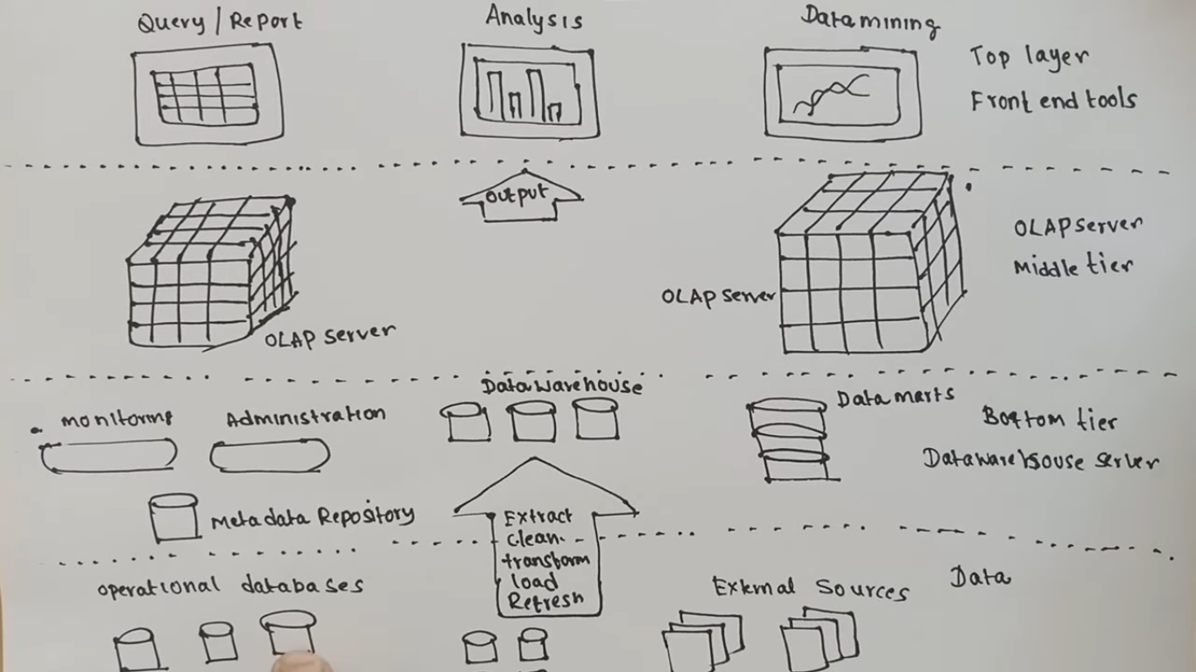

Slide 4
Bottom Tier
Bottom Tier is the foundation of the data warehouse, responsible for collecting, processing, and storing data from multiple sources. It plays a critical role in preparing data for analysis.
Key Components:
Data Sources: Includes operational databases (OLTP systems), flat files, spreadsheets, external APIs, CRM/ERP systems, and web logs. These are the raw inputs feeding into the data warehouse.
Data Storage: Processed data is stored in a Relational Database Management System (RDBMS) or a multidimensional database designed to support structured querying and analysis.

Slide 5
ETL Process (Extract, Transform, Load)
This is the core function of the bottom tier:
Extract: Gathers raw data from different, often incompatible sources.
Transform: Converts data into a consistent format, applying business rules, cleansing errors, handling missing values, and resolving duplicates.
Load: Loads the transformed data into the warehouse, organizing it for fast access and analysis.
This process ensures the warehouse contains clean, reliable, and business-ready data

Slide 6
Middle Tier
The Middle Tier hosts the OLAP server, which processes complex analytical queries. It acts as a bridge between the data storage layer (bottom tier) and the user interface (top tier), ensuring data is quickly retrieved, aggregated, and ready for reporting and analysis.

Slide 7
Top Tier
The Top Tier in the Three-Tier Data Warehouse Architecture comprises the front-end client layer, which is essential for interacting with the data stored and processed in the lower tiers.
This layer includes a variety of business intelligence (BI) tools and techniques designed to facilitate easy access and manipulation of data for reporting, analysis, and decision-making.

Slide 8
BI tools are critical components of the Top Tier, providing robust platforms through which users can query, report, and analyze data. Popular BI tools include:
IBM Cognos: Offers comprehensive reporting capabilities.
Microsoft BI Platform: Integrates well with existing Microsoft products, providing a familiar interface for users.
SAP BW: Specializes in managing large datasets and integrating with other SAP products.
Crystal Reports: Known for its powerful reporting features.
SAS Business Intelligence: Provides advanced analytics.
Pentaho: A versatile tool for data integration and visualization.

Slide 9
Operational Data Store (ODS)

Slide 10
An Operational Data Store (ODS) is crucial in a data warehouse environment because it provides real-time or near-real-time access to operational data, enabling quick decision-making and improved business operations.
Unlike data warehouses designed for historical analysis, an ODS focuses on current, integrated data for immediate operational needs.

Slide 11
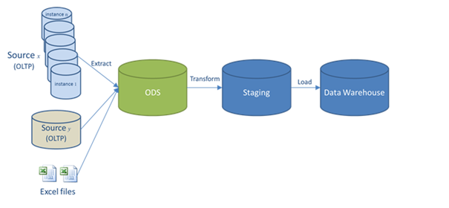

Slide 12
Here's a more detailed look at the importance of an ODS:
Real-time and Near Real-time Data Access:
ODS provides immediate access to the latest operational data, enabling businesses to make informed decisions based on current information. This is critical for industries where swift decisions are vital, such as stock trading or emergency response.
Unified View of Data:
It consolidates data from disparate systems into a single, consistent repository, offering a holistic view of business operations. This eliminates the need to sift through multiple systems for information, improving efficiency and accuracy.
Improved Data Quality:
ODS often includes data cleansing and transformation processes, ensuring data consistency and accuracy across different systems. This leads to more reliable reports and analysis.
Enhanced Decision-Making:
By providing a unified and up-to-date view of operational data, ODS empowers business users to make informed decisions quickly.

Slide 13
Facilitates Business Process Integration:
ODS can integrate data across various business processes, streamlining operations and improving overall efficiency.
Supports Real-time Applications:
It is essential for applications that require real-time data, such as fleet tracking, inventory management, and customer relationship management.
Acts as a Staging Area for Data Warehouses:
ODS can feed data into data warehouses, providing a foundation for historical analysis and strategic planning.

Slide 14
Faster Reporting:
The consolidated data in an ODS allows for quicker generation of reports and real-time insights.
Increased Operational Efficiency:
By providing a centralized and up-to-date view of data, ODS helps businesses identify and resolve issues faster, leading to increased operational efficiency.

Slide 15
ETL AND ELT

Slide 16
ETL Process
ETL is the traditional technique of extracting raw data, transforming it as required for the users and storing it in data warehouses. ELT was later developed, with ETL as its base.
Extract: It is the process of extracting raw data from all available data sources such as databases, files, ERP, CRM or any other.
Transform: The extracted data is immediately transformed as required by the user.
Load: The transformed data is then loaded into the data warehouse from where the users can access it.

Slide 17
ELT Process
Extraction, Load and Transform (ELT) is the technique of extracting raw data from the source, storing it in the data warehouse of the target server and preparing it for end-stream users.
Extract: Extracting data is the process of identifying data from one or more sources. The sources may include databases, files, ERP, CRM, or any other useful source of data.
Load: Loading is the process of storing the extracted raw data in a data warehouse or data lake.
Transform: Data transformation is the process in which the raw data from the source is transformed into the target format required for analysis.

Slide 18
Types of Data Warehouses

Slide 19
Data warehouses come in various forms, each designed to meet specific organizational needs and data handling approaches. Understanding these different types is crucial for choosing the right solution to improve data management and support business intelligence efforts.

Slide 20
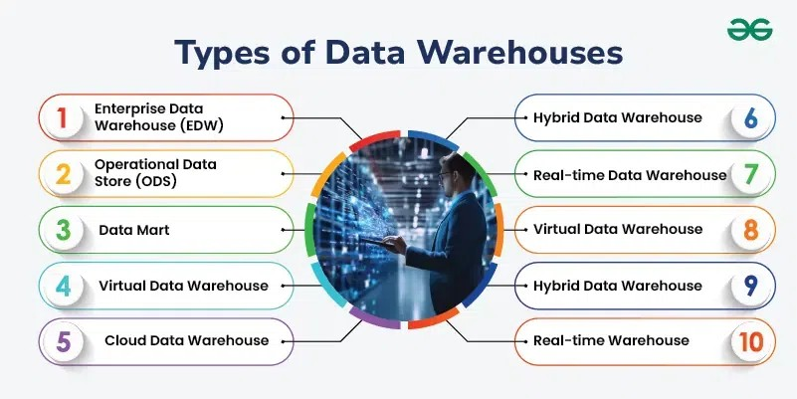

Slide 21
Data warehousing models

Slide 22
Data warehouse models define how data is structured and organized within a data warehouse to support efficient storage, retrieval, and analysis.
The primary models include the star schema, snowflake schema, and data vault model, each with its own strengths for different scenarios.
Additionally, the concept of enterprise data warehouse (EDW), data marts, and virtual warehouses are important architectural considerations.

Slide 23
1. Data Warehouse Schemas:
Star Schema:
This is a simple and widely used dimensional model where a central fact table is surrounded by dimension tables. It is optimized for query performance and is suitable for standard analytics.
Snowflake Schema:
This schema is a more normalized version of the star schema, where dimension tables are further broken down into sub-dimensions, improving storage efficiency but potentially impacting query performance.
Galaxy Schema (Fact Constellation):
This model allows for multiple fact tables that share dimension tables, useful for complex scenarios with multiple interconnected processes.

Slide 24
2. Data Warehouse Architectures:
Enterprise Data Warehouse (EDW):
This is a centralized repository of all organizational data, providing a single version of the truth.
Data Mart:
A subset of the EDW, focused on a specific subject area or business unit, providing focused analytics for a particular team or department.
Virtual Data Warehouse:
This approach doesn't physically store data in a single location but provides a unified view of data from multiple sources through a virtualized layer.

Slide 25
Data warehouse Design Approches

Slide 26
There are two primary approaches to data warehouse design: the top-down (Inmon) approach and the bottom-up (Kimball) approach.
The top-down approach focuses on building a comprehensive, enterprise-wide data warehouse first and then creating data marts, while the bottom-up approach starts with building individual data marts to address specific business needs and then integrates them into a larger warehouse.

Slide 27
Top-Down (Inmon) Approach:
Focus:
Building a centralized, enterprise-wide data warehouse first.
Process:
Involves designing the overall data warehouse architecture, then creating individual data marts based on the warehouse design.
Characteristics:
Data-driven, emphasizing a consistent and integrated view of data across the enterprise.
May involve more upfront planning and a longer implementation time.
Suitable for organizations with well-defined business processes and clear requirements.
Often uses a normalized data model to ensure data integrity and consistency.

Slide 28
Advantages:
Provides a single source of truth for enterprise-wide reporting and analysis.
Ensures data consistency and avoids redundancy.
Facilitates a more structured and organized approach to data warehousing.
Disadvantages:
May require more resources and time to implement.
Can be less flexible to changing business needs.
May not be as quick to deliver value to specific business units.

Slide 29
Bottom-Up (Kimball) Approach:
Focus:
Building individual data marts to address specific business requirements first.
Process:
Involves creating data marts for different business areas or functions, then integrating them into a data warehouse.
Characteristics:
Business-driven, focusing on delivering value to specific business units quickly.
Often uses a dimensional (star or snowflake) schema, which is easier to understand and query.
More flexible and adaptable to changing business needs.

Slide 30
Advantages:
Delivers value to business users faster.
More flexible and adaptable to changing business needs.
Can be implemented incrementally, starting with a few key data marts.
Disadvantages:
May lead to data redundancy and inconsistencies if not carefully managed.
Can be more challenging to integrate data from different data marts into a comprehensive warehouse.
May require more effort to maintain consistent data definitions and structures across data marts.

Slide 31
Define Term Mata data and Data Mart

Slide 32
Mata data
What it is:
Metadata acts as a directory or a blueprint for the data warehouse, providing details about the data's format, location, and relationships.
Why it's important:
Metadata is crucial for tasks like data extraction, transformation, loading (ETL), data modeling, query optimization, and overall data governance.
Types of metadata:
Technical metadata: Includes details about data formats, storage locations, data types, and relationships between data elements.
Business metadata: Describes the business meaning of the data, including definitions, business rules, and data ownership.
Operational metadata: Tracks data lineage, data refresh cycles, and the history of data transformations.

Slide 33
Data Mart
A data mart is a focused, specialized subset of a data warehouse, designed for the analytical needs of a specific department or business unit within an organization.
It provides a more targeted and accessible view of data compared to a full-fledged data warehouse, making it easier for users to find and analyze relevant information.

Slide 34
Types of Data Marts:
Dependent Data Marts: These are built from a pre-existing data warehouse.
Independent Data Marts: These are built from scratch, drawing data from various operational systems.
Hybrid Data Marts: These combine elements of both dependent and independent data marts.

